Slide 1


Your Role in Strengthening Trust in Emergency Management
2025 Access and Functional Needs Summit, 5/7/25, Pierce County Emergency Management, Seattle, WA

Slide 2

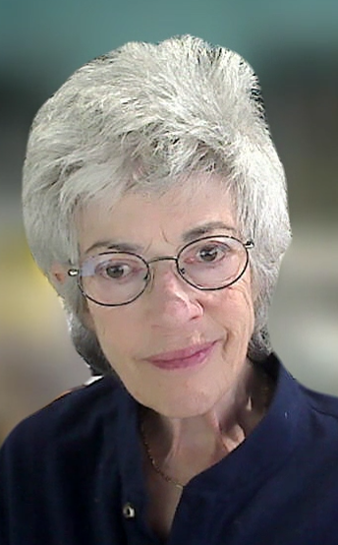
www.jik.com
jik@pacbell.net
Adding Value to Service by Increasing Access
Health Care and Disaster Inclusive Practices
Training, Policies, Processes, & Exercises
Actionable Disability Competencies

Slide 3
Cover
Trust dashboard quiz
Your roles
Example of trust damagers /trust strengtheners
Plans, messages & community involvement
Resources

Slide 4
Trust Dashboard Quiz Results
7–8 A’s: ✅ Strong Trust
4–6 A's: ⚠️ Partial Trust
0–3 A’s: ❌ Low or No Trust

Slide 5
Your Action Plan
What will you:
      Change
      Continue
      Start,
      Stop

Slide 6
Plan Findings
Planning to Plan Someday!
Theoretical & vague "plan-to-plan" terms
Could
May
Might
Will consider
Under development
References to vague agreements/contracts/MOUs

Slide 7
Trust Strengtheners:
Use specific statements to verify the existence of plan capacity.
Replace plan-to-plan, boilerplate, & non-specific text with action details: who, what, where, when, why, & how

Slide 8
Trust Strengtheners:
Pair “under-development statements with accountability details (responsible department, position, & estimated completion date).

Slide 9
Weak:
  Neighbor-to-neighbor alert guidance should be considered for development.
Stronger:
  Neighbor-to-neighbor alert guidance is being developed by Super-Advisor Consulting, the completion date is xx/xx/xx & this guidance will be posted at (insert link).

Slide 10
Trust Damagers: Missing Details
Fears about perceived liability & lawsuits if plans are not implemented exactly as written
Need for operational flexibility
We know what to do & have detailed plans, even if not written

Slide 11
Trust Damagers: Missing Details
Reliance on outdated assumptions
  1st responders will reach people quickly,
  911 culture
Command and control
Underfunded & sporadic public education
Political and public relations pressures
Do not know how to balance transparency with reassurance

Slide 12
Messages: Trust Damagers
Chernobyl Disaster 1986
Hurricane Katrina 2005
Fukushima Nuclear Disaster 2011
Los Angeles Tsunami evacuation route signs 2011
Hawaii alert: Ballistic missile threat inbound 2018
COVID-19 Pandemic 2020–2023
Los Angeles Kenneth Fire 2025

Slide 13
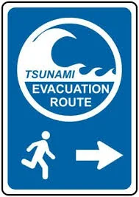
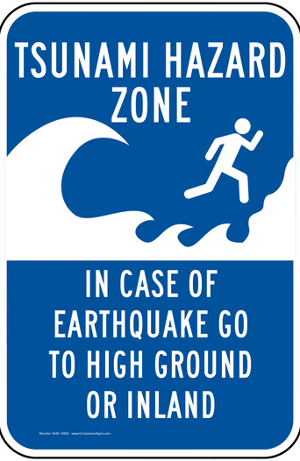


Slide 14
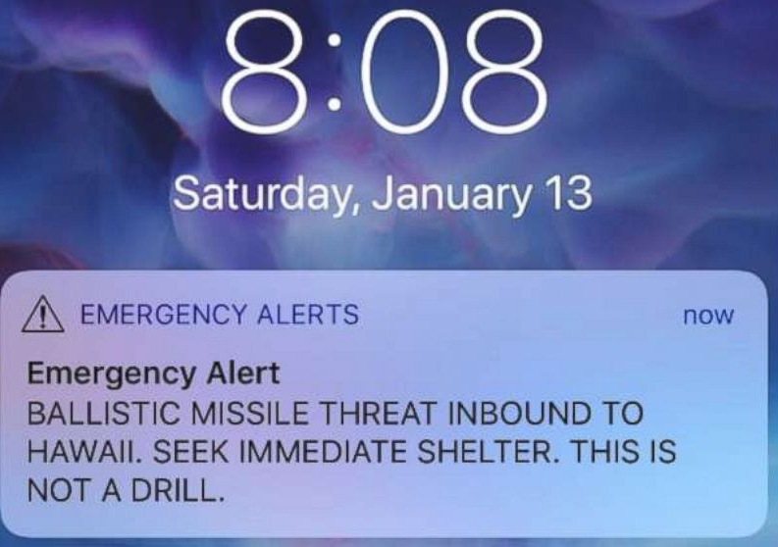

Slide 15
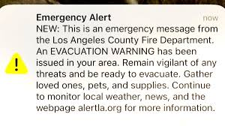

Slide 16
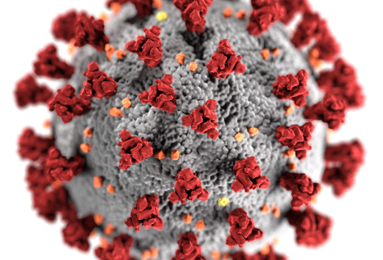
Covid Virus

Slide 17
Trust Strengtheners
Transparency - clearly / honestly communicate realistic response time expectations
Timely, precise, reliable information
Plain language
Multiple channels

Slide 18
Trust Competence
Lucy Jones “Earthquake Lady”
Hurricane Sandy 2012
Los Angeles wildfires 2025

Slide 19
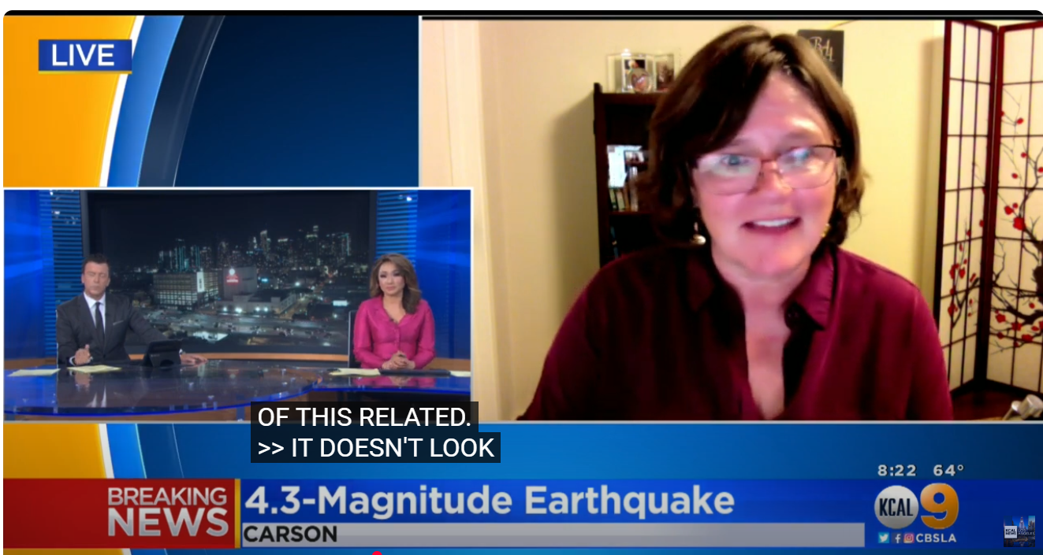

Slide 20
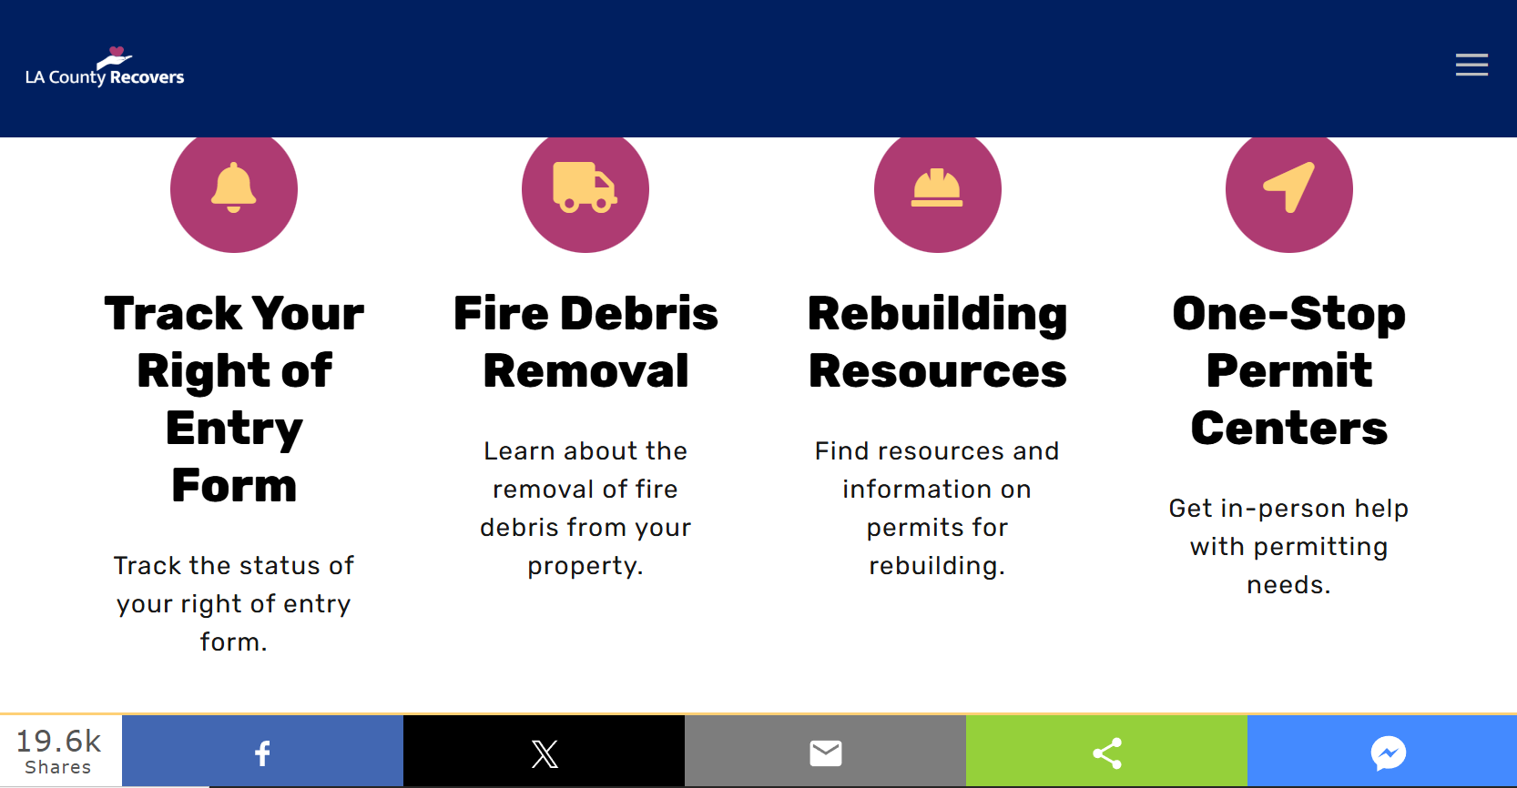
https://recovery.lacounty.gov

Slide 21
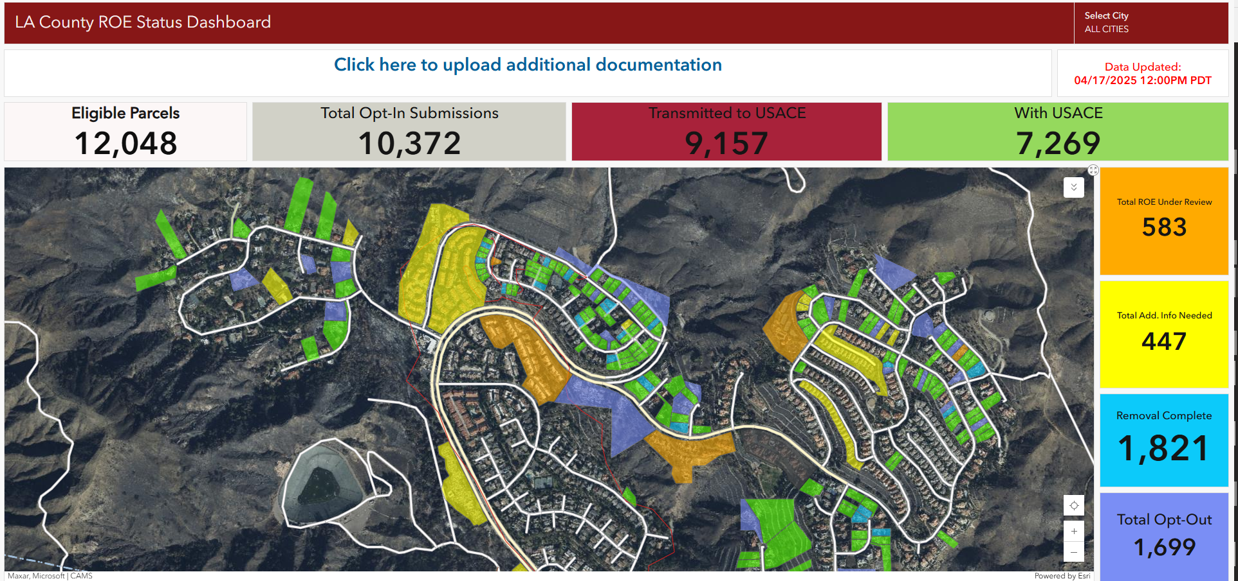

Slide 22
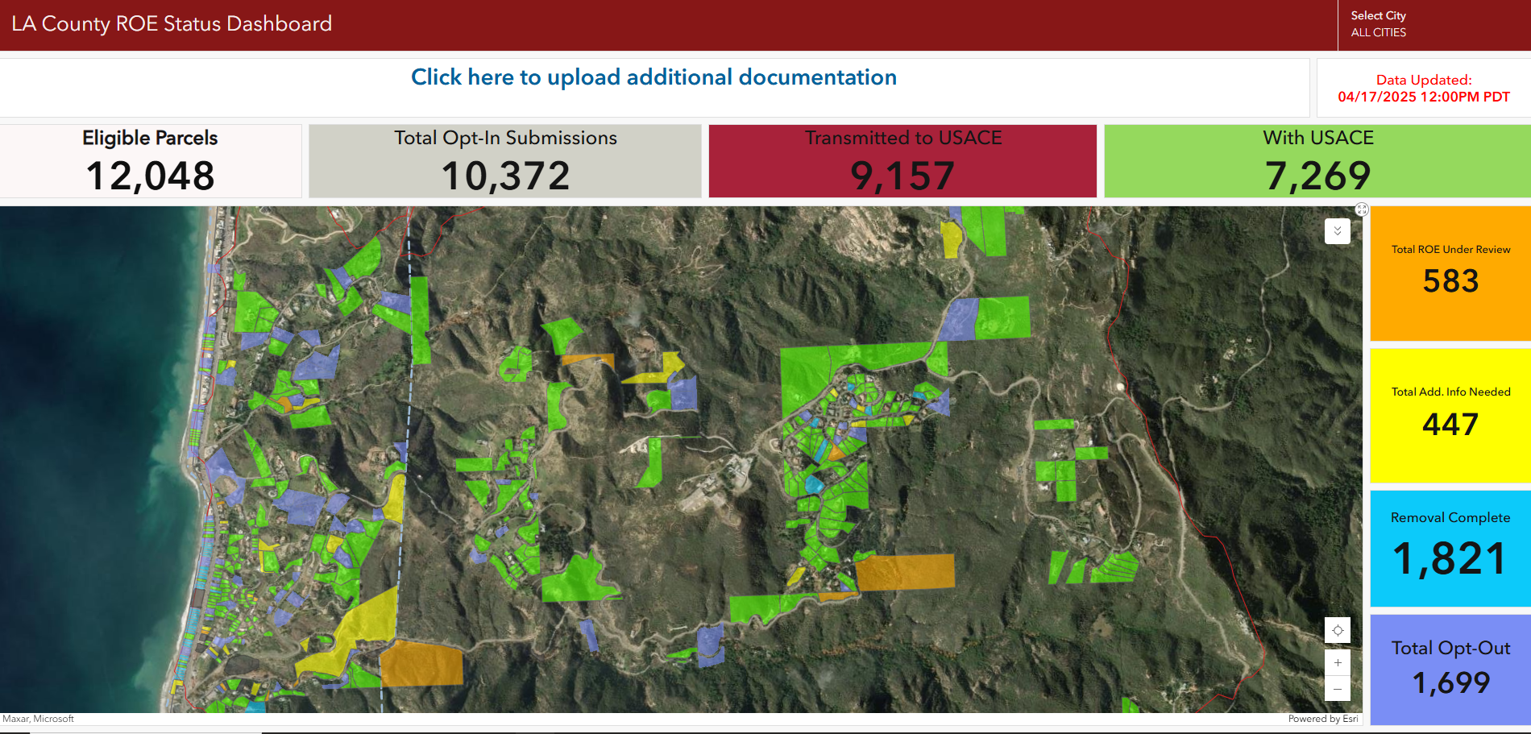
Notes:
Right of entry

Slide 23
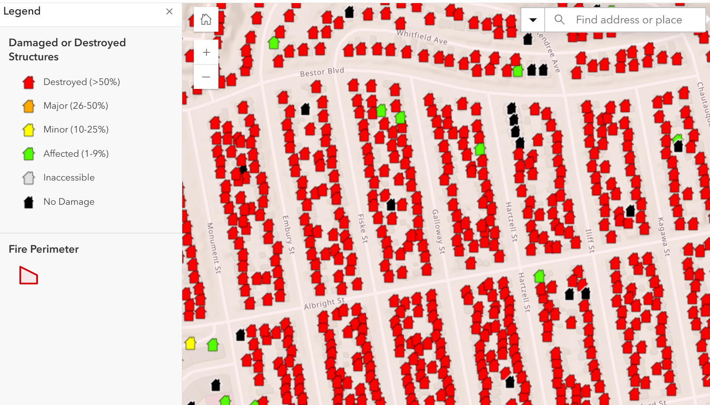

Slide 24
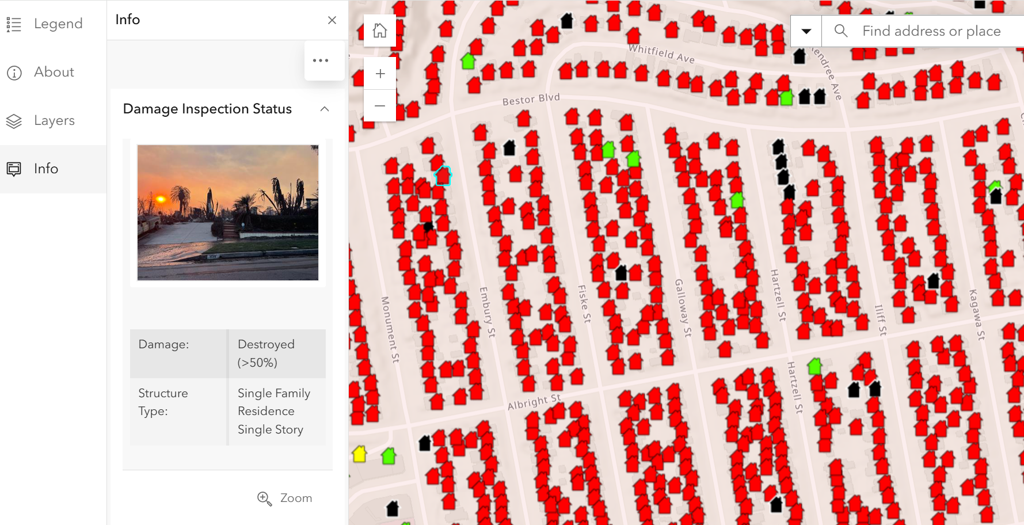

Slide 25
Response Gap
Transparency & honesty with the public
Expose any disaster overpromises
Clear & aimed at bursting magical thinking
    There is a large amount of time when people are on their own!
    1st helpers are not 1st responders; they are nearby neighbors, friends, & family

Slide 26
Weak:
  Neighbor-to-neighbor alert guidance should be considered for development.
Stronger:
  Neighbor-to-neighbor alert guidance is being developed by Super-Advisor Consulting, the completion date is xx/xx/xx & this guidance will be posted at (insert link).

Slide 27
Weak:
  People needing transit evacuation help should call 911.
Stronger:
  Individuals needing transit evacuation help can use xxx.xxx.xxxx (phone, text) to ask for help evacuating.

Slide 28
Token Engagement: Trust Damagers
Resistance to a Culture Shift
Advisory groups are to “check a box” to fulfill mandates
Top-down government-centric emergency management
Talking to versus talking with

Slide 29
Community Involvement Trust Damagers
Minimal or no involvement
Decisions made without public input
Participants are usually the same “insiders & officials”
Disrespecting & disregarding public input, ignoring concerns, or dismissing local experiences
Reactive & isolated planning
Notes:
Q notes only Since 2008, AE and I, in our free time & I here some of you snickering & laughing), have been exploring this complex issue, peeling away at the onion layers, through informal interviews, readings, discussions, debates, and integrating of new learning resulting from opportunities to build upon this information through workshops over the years!
there is a:
Oversimplification of the issues
Shallow guidance
Over promise of response &
Underestimation of resources
Lack of outcome evidence
this l is a preview, from a working draft of a paper which we plan to publish.
I’d like your:
Your thoughtful reactions
Volunteer reviewers of our draft paper Ideas (especially from em’s and planners re: electronic journal (where we could get this out quickly, compared to the geologic time it takes to get items published in hard copy only journals.
// add journals
Journal of Homeland Security and Emergency Management (JHSEM)
DomPep Journal
Journal of Emergency Managemen

Slide 30
Accountability: Trust Strengtheners
Reflects diversity of community
Respect for local knowledge, expertise, & opinions
Engagement ongoing & meaningful
Follow up consistent, tracked, honored, & reported back
Staff, backup staff, consistent funding.
Outcomes tracked

Slide 31
Weak:
The County:
  Plans to develop multi-lingual templates for evacuation notices, warnings, & instructions.
  Plans to reach all segments of the population regardless of their access to technology.

Slide 32
Specific messaging contract deliverables:
Customize distribution to diverse communities - quarterly & before, during, & after emergencies
Use multiple languages & culturally appropriate content
Test (numbers reached, accessibility, understandability

Slide 33
Specific messaging contract deliverables:
Use of multiple accessible communication methods
Web pages incorporate, test for, & maintain accessibility
New educational materials must be delivered in accessible formats

Slide 34
Weak:
  Individuals should develop a personal emergency evacuation plan as more people may need transit evacuation help than what will be available.
Stronger:
  More people may need transit evacuation help than will be available. Help with creating personal emergency transit evacuation plans is available from the attached list of community partners (insert link).

Slide 35
Individual preparedness plans:
Signing up for local alerts & notifications
Plans to shelter in place or evacuate
Plans for power outages
Labeling equipment
Develop helper list – check on & help each other
Develop communications plans
Collect critical documents

Slide 36
WAOOO is better than
YOYO

Slide 37
No Trust: Registries Fatal Flaws
Underestimation of response capacity
Based on fixed locations
  Wasted trips & wasted time
  Medical model biases
Not inclusive
Lacks outcome evidence
Diverts people from energy should devote to personal plans

Slide 38
No Trust: Registries Fatal Flaws
Underestimation of response capacity
Based on fixed locations
  Wasted trips & wasted time
  Medical model biases
Not inclusive
Lacks outcome evidence
Diverts people from energy should devote to personal plans

Slide 39
Trust: Move Away From Registries
Honesty & shift from magical thinking to real solutions
Respect for subject matter experts & local knowledge, & opinions,
Engaging community in problem-solving & shaping preparedness, planning, response, & recovery
Invest in the hard work
Use better planning tools
Promote personal preparedness

Slide 40
Trust: Registries may check a box, but real safety, & real resilience come from doing the real work!
June Kailes

Slide 41
Trust Resources
Building Trust in Emergency Planning and Response Podcast (21 minutes) (2025) Note: It takes a few minutes to load.
Trust in Emergency Management Dashboard Quiz (2025)
Trust versus No Trust Examples in Emergency Management (2025)
Your Role in Strengthening Trust in Emergency Management Slides (2025)

Slide 42
Tansit Evacuation Resources
Making Transit Evacuation Real for All (2025) (Podcast 21 minutes) (2025)
2 new resources will be available @ https://disasterstrategies.org under “USEFUL INFO” (2025)
  Transit Evacuation Plans for People with Disabilities: Key Integration Details
  Disability Emergency Personal Evacuation Transportation Planning
Inclusive Evacuation and Transportation. CalOES (2024) 4 hour course https://csti-ca.csod.com/UI/LMS-LEARNING-DETAILS/APP/COURSE/9D3F79CA-8051-4977-A3EA-1E0DB879C107

Slide 43
Resources
Developing and Maintaining Emergency Operation Plans, Comprehensive Preparedness Guide (CPG) 101. FEMA (2021) https://www.fema.gov/sites/default/files/documents/empty.txt
Inclusive Evacuation and Transportation. CalOES (2024) 4 hour course https://csti-ca.csod.com/UI/LMS-LEARNING-DETAILS/APP/COURSE/9D3F79CA-8051-4977-A3EA-1E0DB879C107
The Return on Investments in Public Engagement (2024) https://www.domesticpreparedness.com/articles/return-on-investments-in-public-engagement?utm_source=DomesticPreparedness&utm_campaign=25a1e96667-EMAIL_CAMPAIGN_2024_01_03_09_50_COPY_01&utm_medium=email&utm_term=0_-bea7c13990 5BLIST_EMAIL_ID%5D

Slide 44
Registry Resources
Beyond Registries: Better Solutions For People With Disabilities (2023
    https://domesticroipreparedness.com/articles/bey ond-registries-better-solutions-for-people-with-disabilities
http://www.jik.com/d-rgt.html
Emergency Registries: A Misleading, Harmful & Non-Inclusive Fix 9/8 & 10/13 2022
  Part 1
  https://youtu.be/mexNCwt1lw8
  Part 2 https://www.youtube.com/watch?v=oRyvS9TG1QQ

Slide 45
Emergency Registries for People with Access & Functional Needs http://www.jik.com/d-rgt.html
What is a Registry?
Emergency Registry Assessment Tool
Flowchart: Deciding to Use an Access & Functional Needs Emergency Registry
Stakeholder Opinions of Registries
Registry Websites
Papers, Presentations, Webinars, Resources

Slide 46
Being at the table is not enough.
Build partnerships, capability & capacity.
Make a difference & an impact.
To settle for less does a disservice to you, the people you support, & those who come after you.
June Kailes

Slide 47
“Not to know and do nothing about it is forgivable.
To know and do something about it is admirable.
To know and do nothing about it is unforgivable.”
Source Unknown

Slide 48
Being at the table is not enough.
Don’t merely abide; lesser deeds will not turn the tide.
Avoid the vague, puffy, and fluffy.
Craft the actionable and the practical.
Build partnership capability and expand capacity wide, let impact be your guide.
Never settling for less, we strive for the best for ourselves and others on this lifelong quest.
— June Kailes (2024)

Slide 49
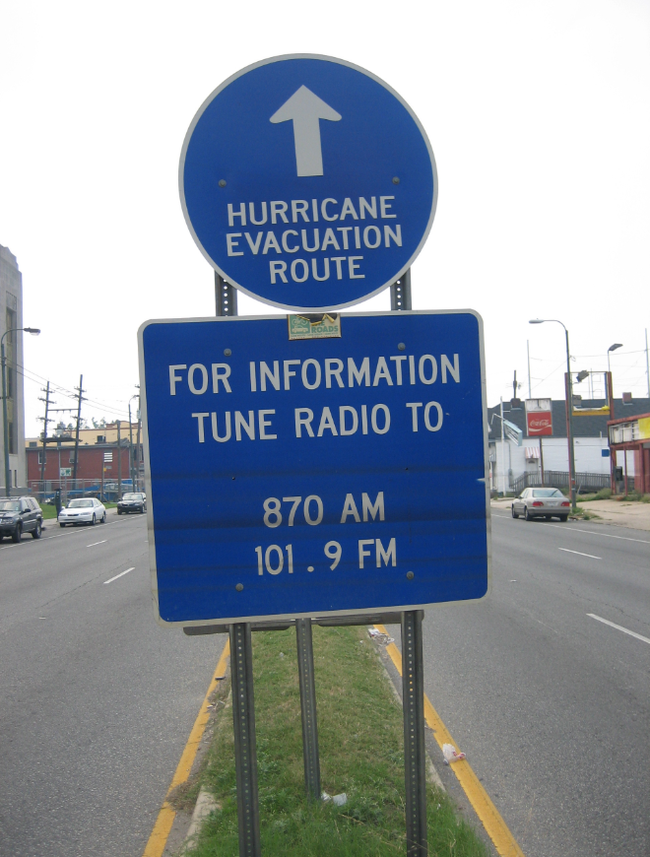
A hurricane evacuation route sign in New Orleans [2005] marked by floodwater lines after Katrina. This image shows the results of communication failures – when evacuation messages are missed or delayed, the results can be devastating.​
Notes:
Source: https://commons.wikimedia.org/wiki/File:Hurricane_Route_sign_Tulane_Avenue_floodlines.jpgs

